Slide 1
Lesson 3

Slide 2
Greetings
How was your week?
How was your weekend?
What did you do this week?
What did you do today?

Slide 3
Today's Plan
Sushi Passage
Preposition Practice
Introduction to Irregular Verbs
Start Travel Unit

Slide 4
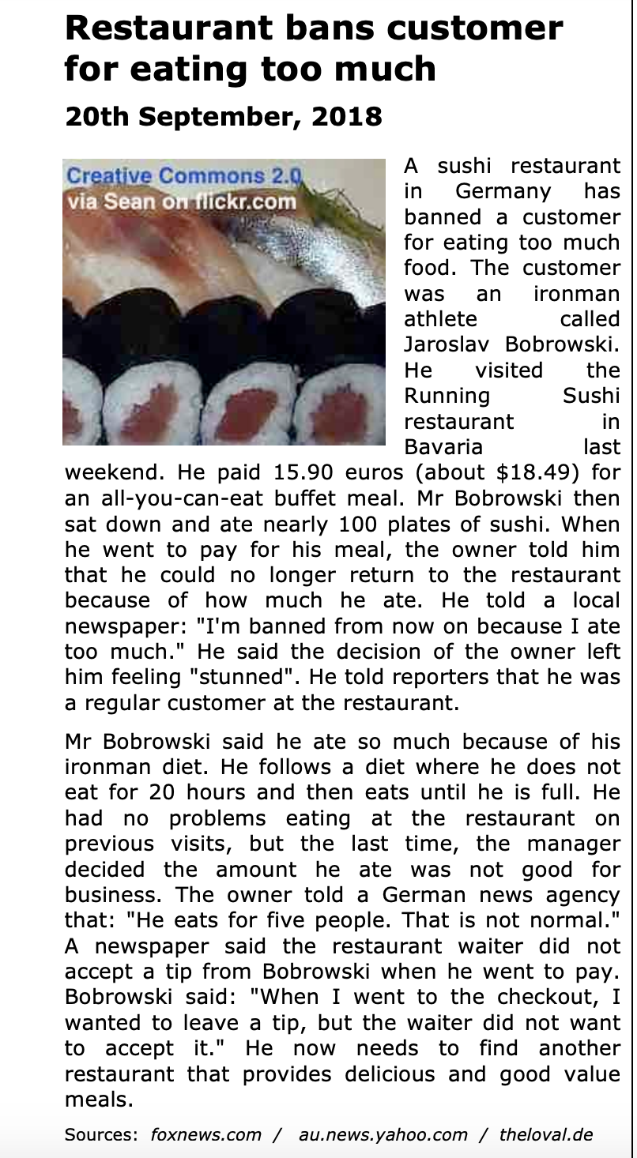
Reading Time!

Slide 5

Prepositions

Slide 6
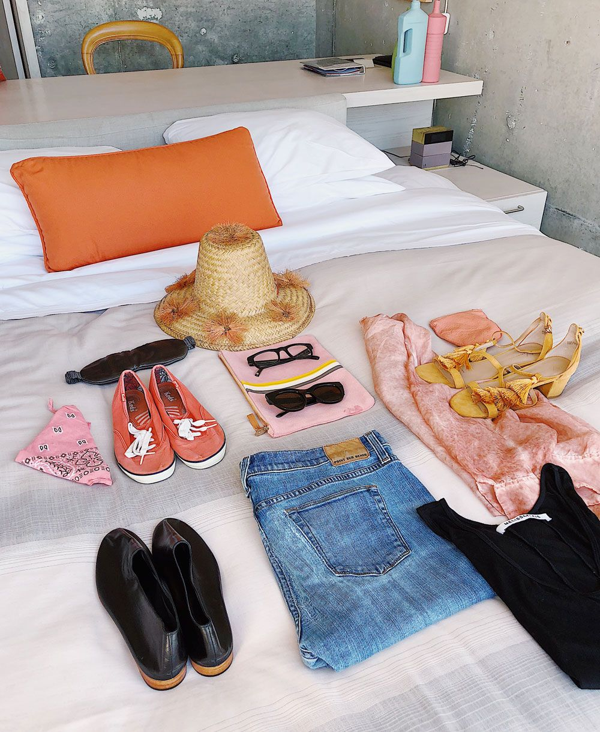
Prepositions

Slide 7
Irregular Verbs
An irregular verb is one where the past tense does not seem to follow a sort of rule in comparison to the present tense.
Can you think of any irregular verbs? Let's make a list!

Slide 8
Irregular Verbs
Present → Past
I am/he is/we are → I was/he was/we were
I am a worker. → I was a student.
I am reading the book. → I was watching TV.
I write → I wrote
I write in my notebook. → I wrote a letter.
I draw → I drew
I draw a flower. → I drew a house.
Past tense words: yesterday, last week, (anything that describes a day that is before today)
I do → I did
I do exercise. → I did (had) a barbecue.

Slide 9
I make → I made
I make a cake. → Yesterday I made chicken.
I meet → I met
I meet my neighbor. → Three years ago, I met my husband!
Present tense words: today, right now…
I pay → I paid
Today I pay for my car. → Yesterday I paid my security deposit.
I send → I sent
I send mail. → I sent a letter.
I sleep → I slept
Today I go to sleep early. → Yesterday I slept late.
I sleep in my bed. → I slept in that bed.

Slide 10
I stand → I stood
I stand all day. → Yesterday I stood all day.
I stand in line at the store. → Yesterday, I stood in line at the store.
I read (sounds like reed) → I read (sounds like red)
I cut → I cut
I cut with scissors. → Yesterday I cut my hair.
I buy → I bought (sounds like bot)
I buy food today. → Last week I bought food at the store.
I see → I saw
I see you right now. → I saw my mom yesterday.

Slide 11


Slide 12
Travel

Slide 13
Discussion Questions
How do you get to work? How long does it take you to get to work?
Do you have a driver's license?
Do you own a car?
What is the speed limit in your city?
How much is bus fare in your city? Does your city bus company offer monthly bus passes? If so, how much are they?
Do you have to pay for bus transfers? How long is a bus transfer valid?

Slide 14
Discussion Questions
Do you like traveling?
When you go on a vacation, what is your favorite method of travel?
Do you get seasick, airsick, or carsick when you travel?
If you could take a trip anywhere in the world, where would you choose to go?
What is the difference between a hotel and a motel?
When you take a vacation, what is your favorite type of accommodation—hotel, motel, inn, B&B, hostel, tent, R.V., house share, etc.?

Slide 15
Discussion Questions
What is the longest plane trip you have ever taken? Where did you go?
Have you ever been bumped from an airline because of overbooking?
Have you ever been on a cruise?
Have you ever lost your luggage on a trip?
Do you like airplane food?
When you fly, do you prefer a window seat, a middle seat, or an aisle seat?
What is the best (or worst) trip you have ever taken?

Slide 16
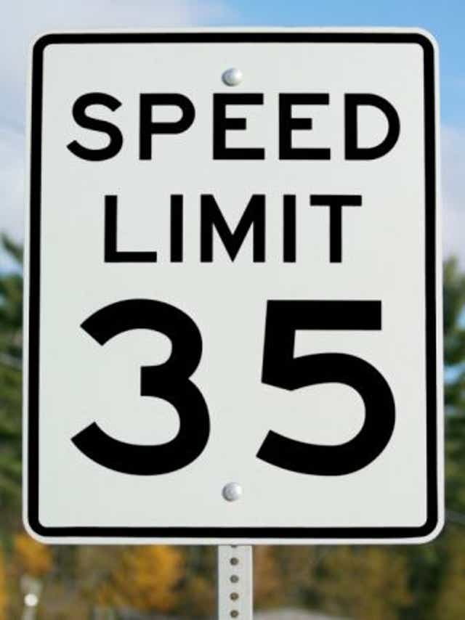
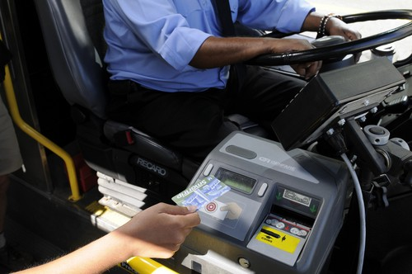
Vocabulary
speed limit →
bus fare →
the maximum speed you are allowed to drive according to the law
the cost of a bus trip

Slide 17
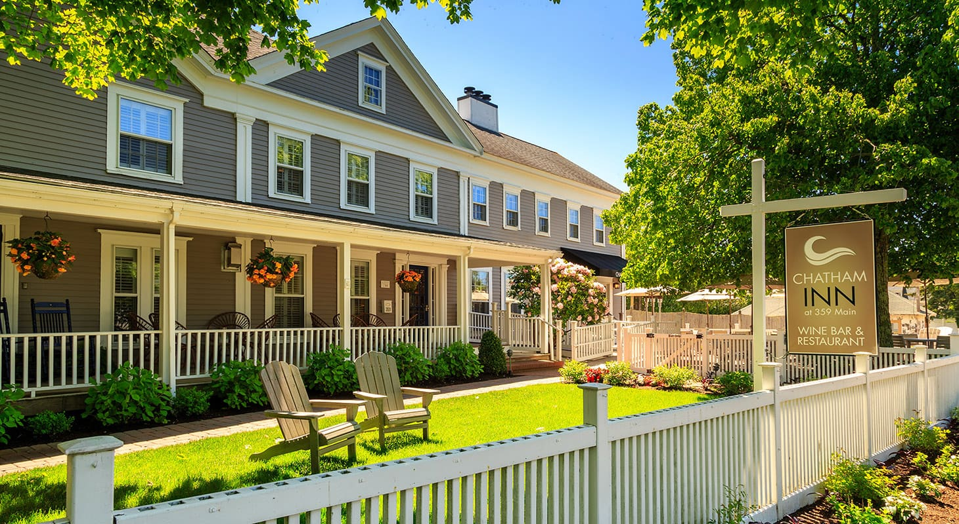
Vocabulary
bus transfer →
accommodation →
inn →
a ticket or paper that allows you to change from one bus to another
a place to stay
another word for hotel

Slide 18
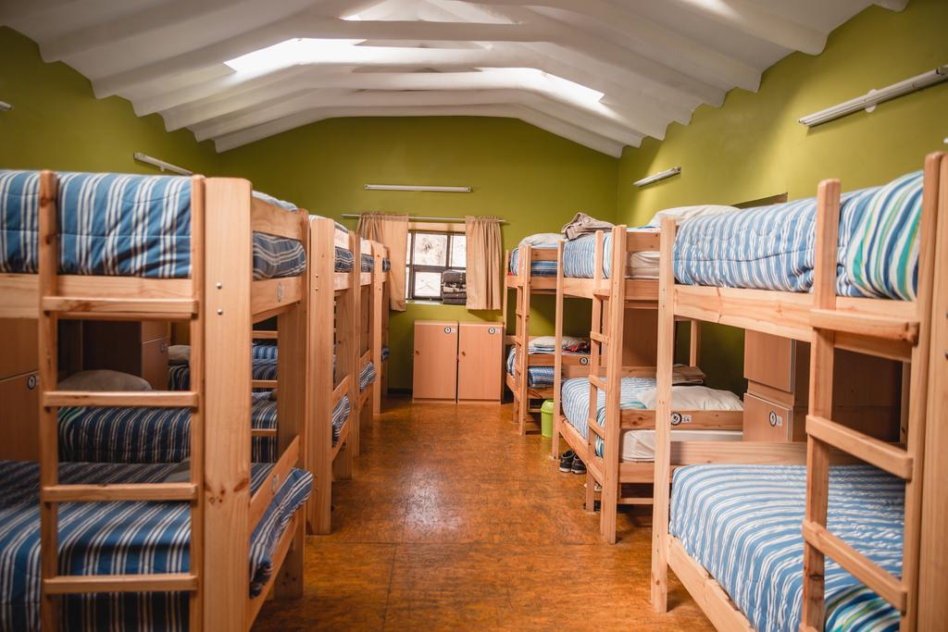
Vocabulary
B&B →
hostel →
also called a bed and breakfast; a type of accommodation, usually in a person's home;
a building that provides cheap sleeping accommodation; usually several people sleep in the same room; very common type of accommodation for young people

Slide 19
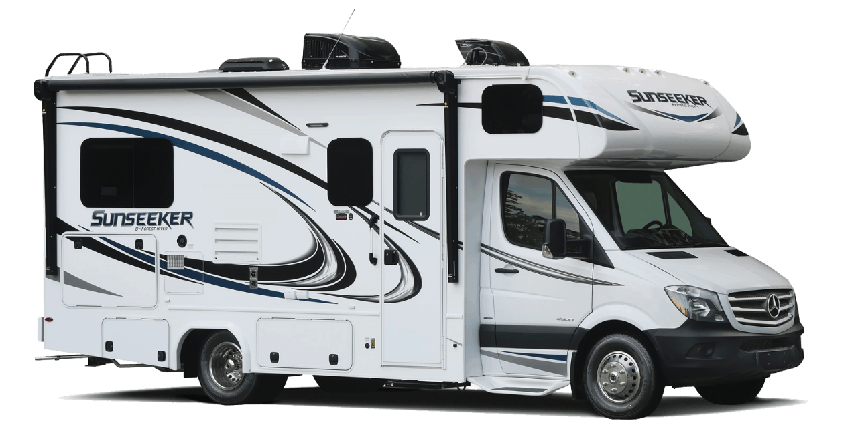
Vocabulary
R.V. →
to book →
recreational vehicle, camper, a home on wheels
to reserve, save a place

Slide 20
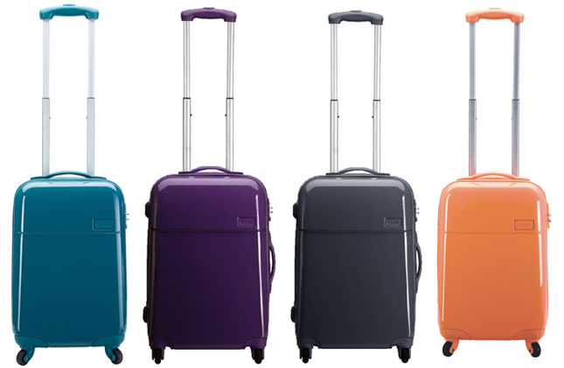
Vocabulary
to overbook →
luggage →
to take more reservations than there are places for; to sell more tickets than there are seats for
baggage, suitcase

Slide 21
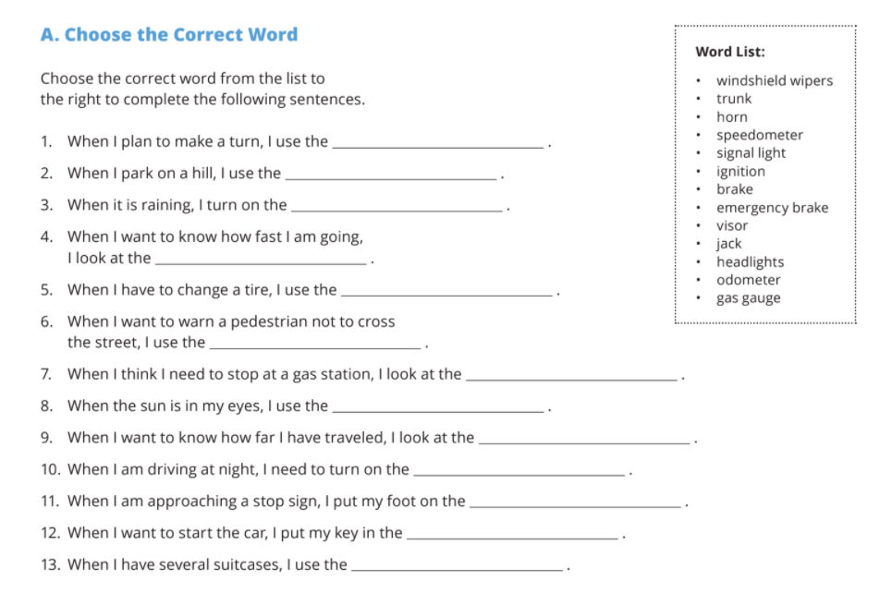

Slide 22
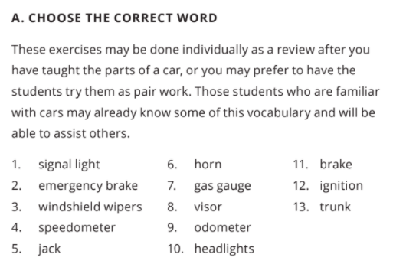

Slide 23
Lesson Summary:
Today we:
Re-read the sushi passage
Practiced using prepositions
Began our learning on irregular verbs
Started the travel unit
Homework: Since we didn't get to it last week: choose 5 irregular verbs from the list and use them to make sentences about the past.

